Slide 1
NLP: Let the Machine Do the Reading
Real World

Slide 2
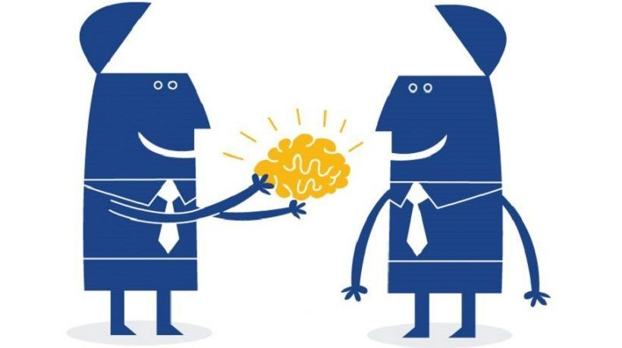
Pre-Trained Models
NLP is a pre-eminent AI technology that enables machines to read, decipher, understand, and make sense of human languages
For building NLP applications, language models are the key. However, building complex NLP language models from scratch is a tedious task
This is why we use pre-trained language models
Transformer-based NLP models are leading

Slide 3
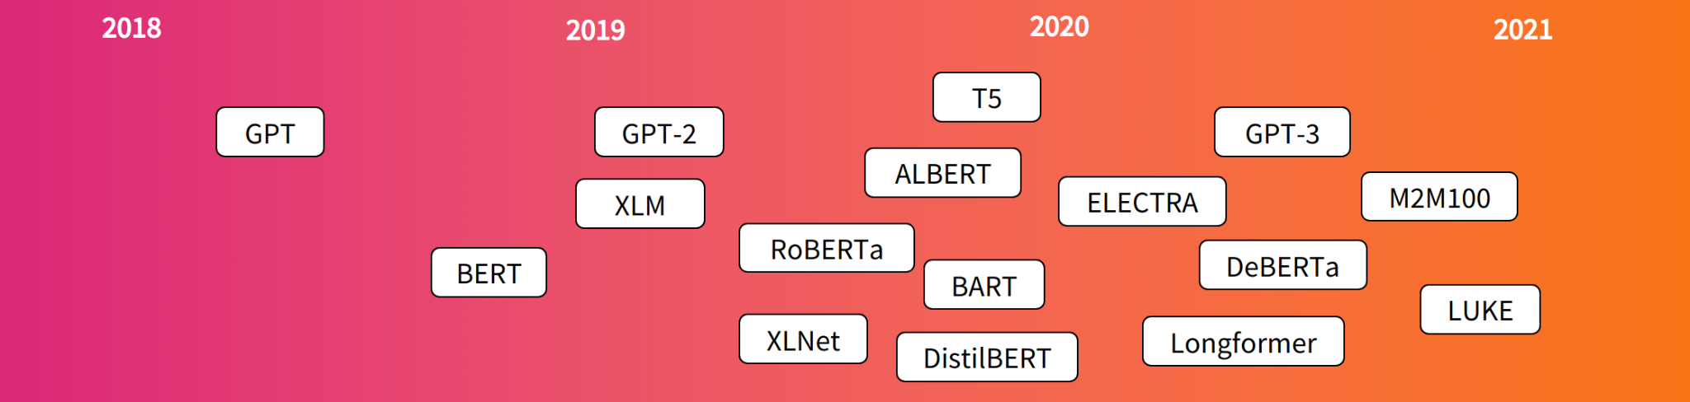
Transformer-Based Models

Slide 4
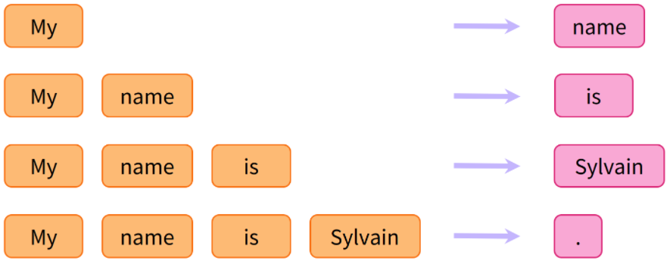
Casual Language Modelling

Slide 5
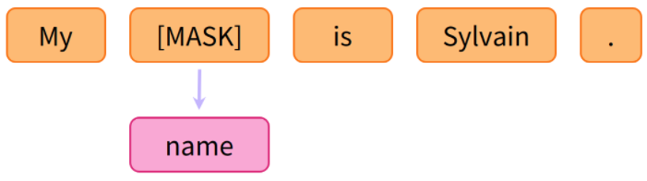
Masked Language Modelling

Slide 6
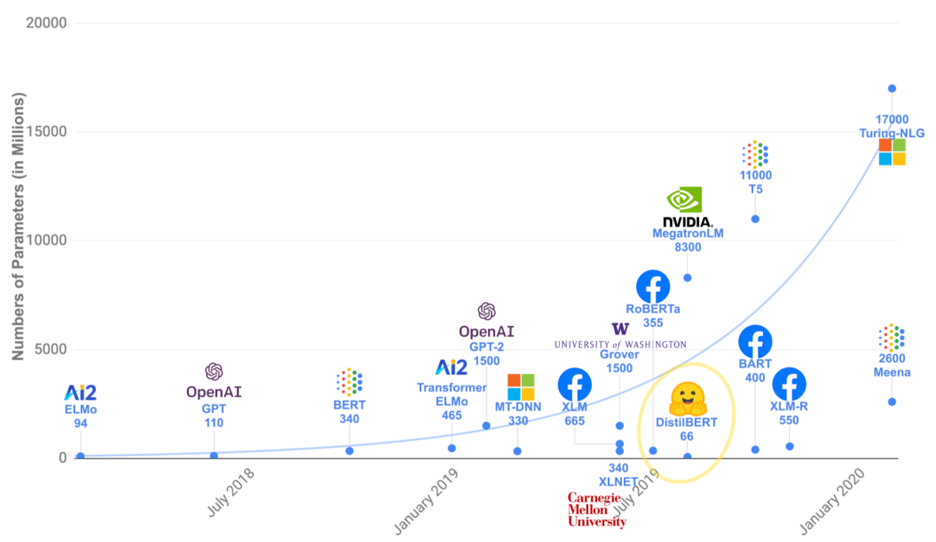
Transformers are Big Models

Slide 7
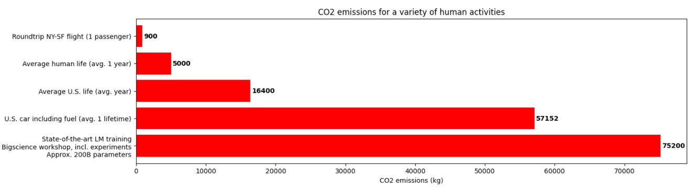
Transformers are Big Models

Slide 8
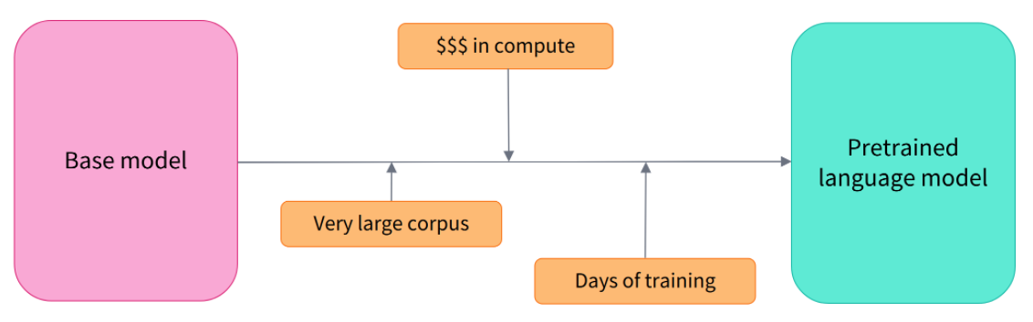
Transfer Learning
Pretraining is the act of training a model from scratch: the weights are randomly initialized, and the training starts without any prior knowledge.

Slide 9
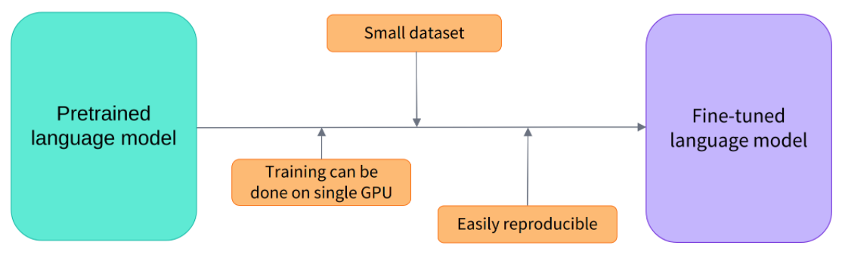
Transfer Learning
The fine-tuning will only require a limited amount of data: the knowledge the pretrained model has acquired is “transferred,” hence the term transfer learning.

Slide 10
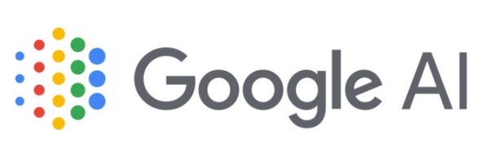
BERT
Bidirectional Encoder Representation from Transformers
Developed by Google
Utilizes the Transformer architecture; only the encoder mechanism
Trained on 2,500 million Wikipedia words and 800 million words of the BookCorpus dataset
Best for any task that transforms an input sequence to an output sequence, such as speech recognition, text-to-speech transformation, etc.
https://huggingface.co/transformers/model_doc/bert.html

Slide 11
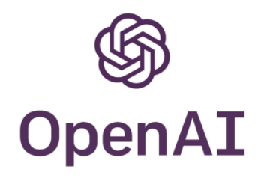
GPT-3
Generative Pre-trained Transformer 3
Developed by OpenAI
Utilizes the Transformer architecture; only the decoder mechanism
Trained on over 175 billion parameters on 45 TB of text from all over the internet, making it one of the biggest pre-trained NLP models available
Best for translation, question-answering, reading comprehension tasks. Recently it was enhanced to write news articles and even generate code.
https://huggingface.co/transformers/model_doc/gpt.html

Slide 12
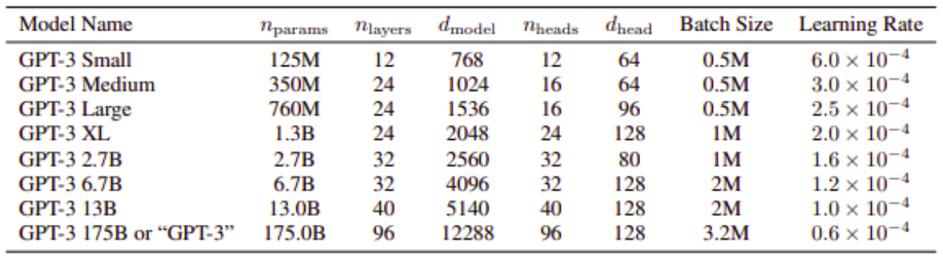
GPT-3

Slide 13
T5
Text-To-Text Transfer Transformer
Developed by Google
Utilizes the Transformer architecture; an encoder-decoder model
Trained on a 750 GB cleaned scraped text from web pages
Best for generating new sentences depending on a given input, such as summarization, sentiment analysis, question answering, and machine translation
https://huggingface.co/transformers/model_doc/t5.html

Slide 14

Building an AI Application with Pre-Trained NLP Models
All the pre-trained models are open source and available to download
But which NLP model works best for your AI project?
Depends on: scale of the project, type of dataset, training methodologies and several other factors

